Slide 1


Sri Lanka Institute of Information Technology
Faculty Of Computing
Empowering Hair Health with Intelligent Hair Disease Detection Systems
Final Presentation
2023 - 154
IT4010 | 2023

Slide 2
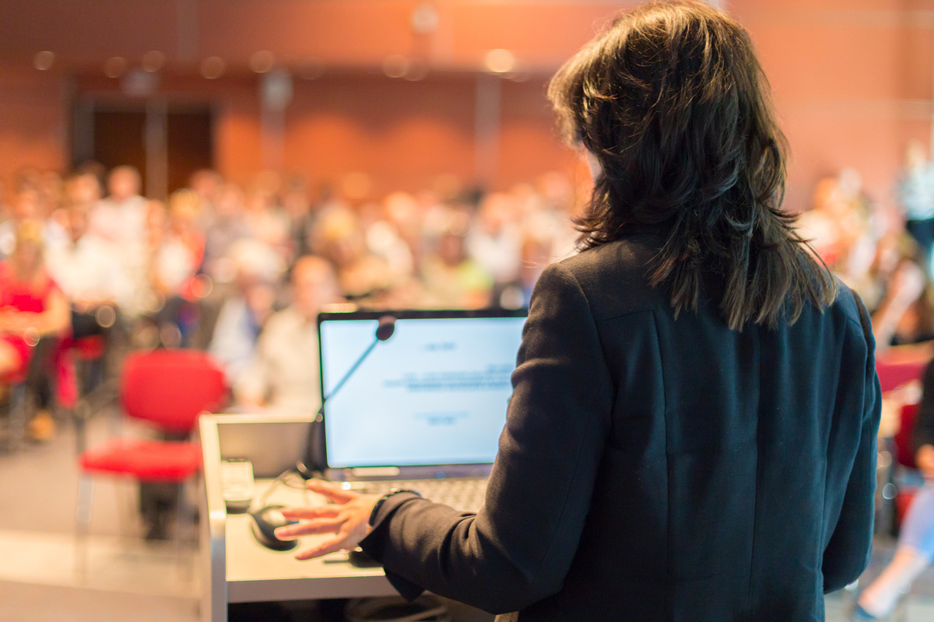

Group Details​
Supervisors
Student
Supervisor – Ms. Lokesha Weerasinghe ​
Co-Supervisor – Ms. Thamali Dassanayake​
External–Supervisor - Dr. Mallika Hewawitharana​
STUDET NAME​ STUDENT ID​
Wickramarathma D.G.N.L​ IT20154158​
Nanayakkara V.G​ IT20159580​
Bandaranayake V.R.W​ IT20232290​
Alahakoon D.Y.R​ IT20129026​
2023 - 154
IT4010 | 2023

Slide 3
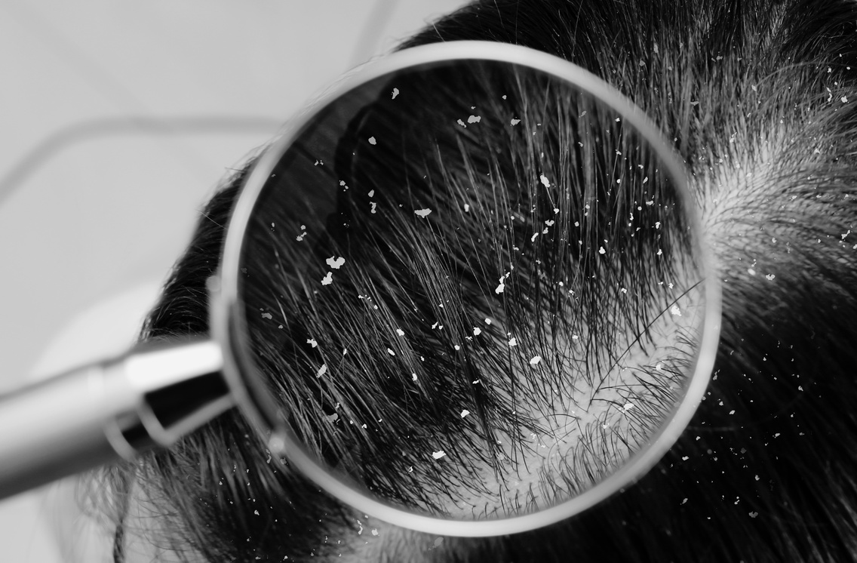
INTRODUCTION​
We propose this application detects hair disease.​
Recommend the treatment.​
Predict the symptoms and side effects.​
Scanning prescription, scheduling doctors’ meetings and showing reminders. ​
Use 5 Hair Diseases for that project.​
Head Lice​
Alopecia Areata​
Telogen Effluvium​
Tinea Capitis​
Folliculitis
2023 - 154
IT4010 | 2023

Slide 4

RESEARCH PROBLEM
High cost of full hair diseases analysis. ​
Lack of awareness of hair diseases information​
Inability to identify what hair disease is due to the inherent characteristics of different hair diseases.​
Not being able to identify the necessary treatment in a way that does not damage the hair.​
2023 - 154
IT4010 | 2023

Slide 5

MAIN OBJECTIVES​
The main objective of "Empowering Hair Health with Intelligent Hair Disease Management Systems" research is to identify, understand, and develop effective treatments for various hair and scalp disorders that affect human beings. All are done in the mobile application through.​
2023 - 154
IT4010 | 2023

Slide 6

SUB OBJECTIVES​
Extracting patient prescription data using easyOCR and setting reminders using those data.​
Hair Disease Treatment Recommendations for Using Machine Learning-based Model.​
Predicting symptoms and side effects using hair disease.​
Automatic hair scratch and hair losing detection using IOT device with machine learning.​
2023 - 154
IT4010 | 2023

Slide 7
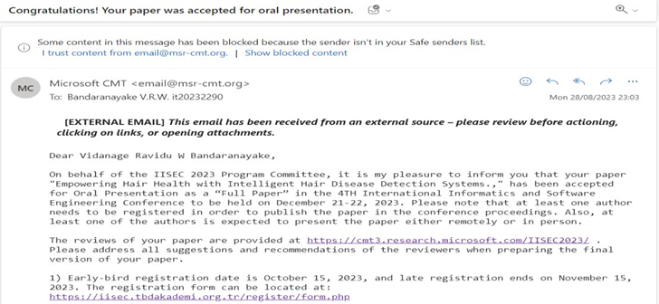

RESEARCH PUBLICATIONS​
IISEC
2023 - 154
IT4010 | 2023

Slide 8
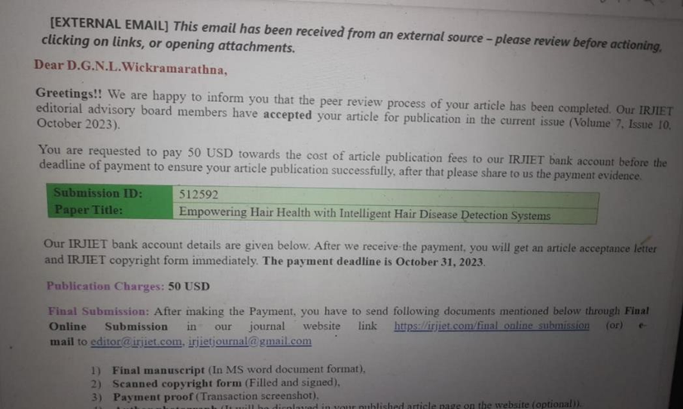

RESEARCH PUBLICATIONS​
IRJIET
2023 - 154
IT4010 | 2023

Slide 9
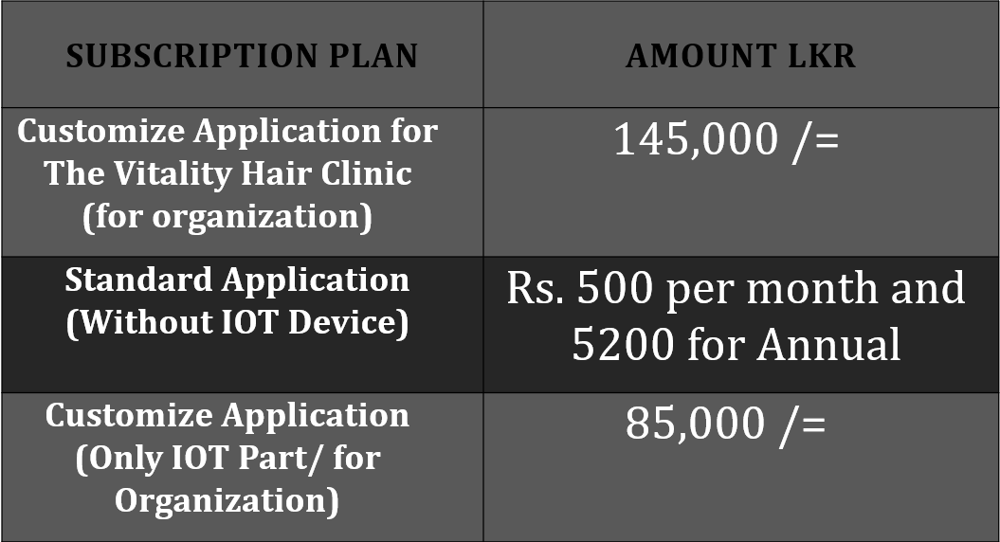

COMMERCIALIZE
App Icon
2023 - 154
IT4010 | 2023

Slide 10
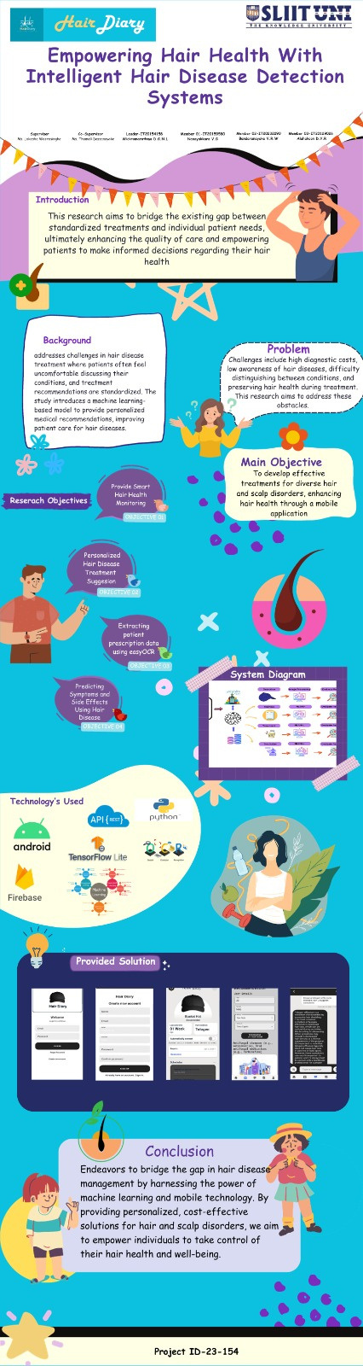
Poster
https://mysliit.sharepoint.com/:i:/s/CDAPSubmissionCloud/EbiTqPvSUJtOiog6YiovquYBB4vzoM9H5Wh6VdlVsPDPSw?e=Qyw6Vp

Slide 11
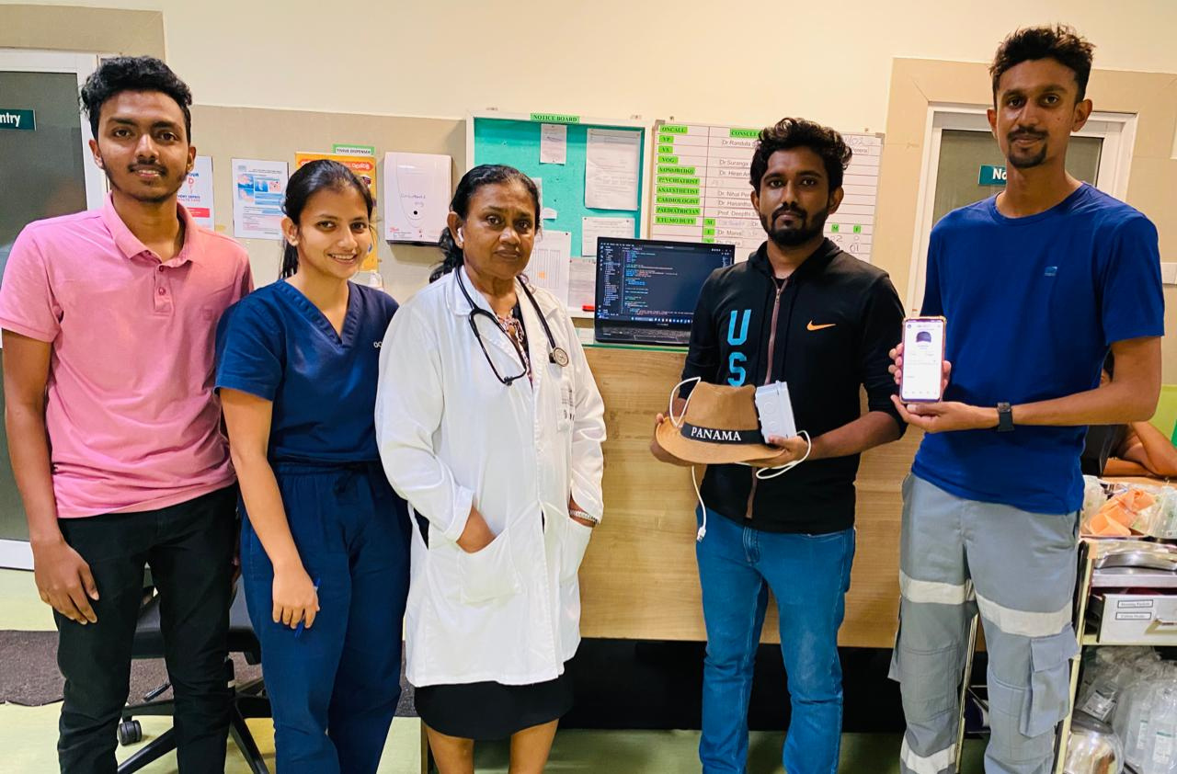
Meet the doctor evidence

Slide 12

IT20154158​
Wickramarathna D.G.N.L​
Specialize in Information Technology​
2023 - 154
IT4010 | 2023

Slide 13

Extracting patient prescription data using easyOCR and set reminders using those data ​
2023 - 154
IT4010 | 2023

Slide 14

BACKGROUND​
How to extract patient prescription data.​
How to set the reminders for take medicine and next the doctor meeting time according extracted patient prescription. ​
2023 - 154
IT4010 | 2023

Slide 15
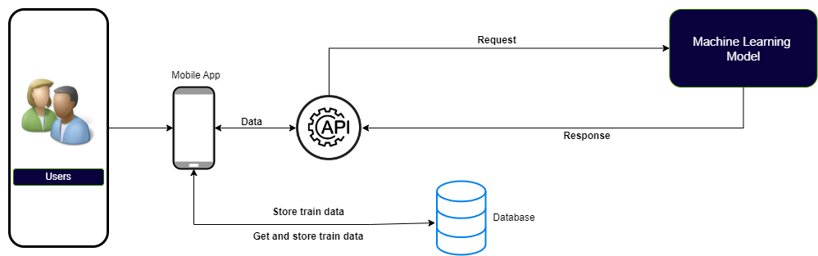
SYSTEM DIAGRAM
2023 - 154
IT4010 | 2023

Slide 16

RESEARCH GAP​
​
Exploring Methods for Semantic Understanding of Extracted Prescription Data.
Research methods for personalizing medication and appointment reminders to suit individual patient preferences and needs.
2023 - 154
IT4010 | 2023

Slide 17
Specific Objectives
MAIN OBJECTIVE​
Showing prescription data using easyOCR.​
Use that information to set reminders.​
SUB OBJECTIVE​
Call the doctor mentioned in the prescription.​
Edit and set different reminders using the extracted data.​
2023 - 154
IT4010 | 2023

Slide 18




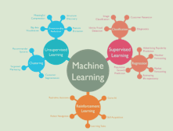
TECHNOLOGIES
2023 - 154
IT4010 | 2023

Slide 19
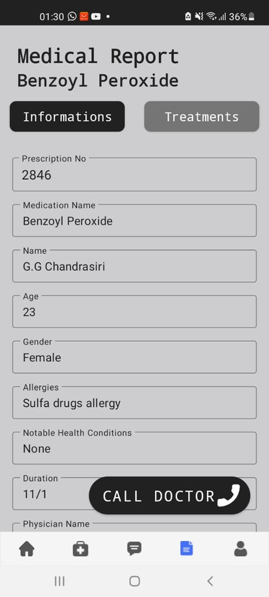
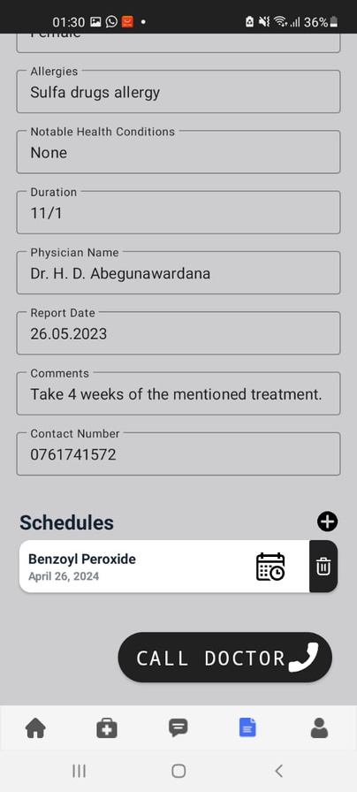
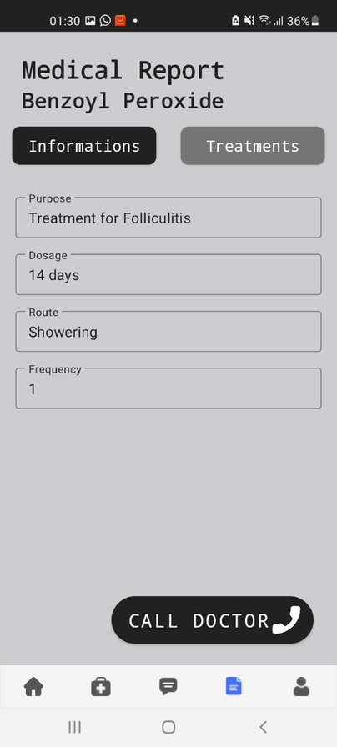
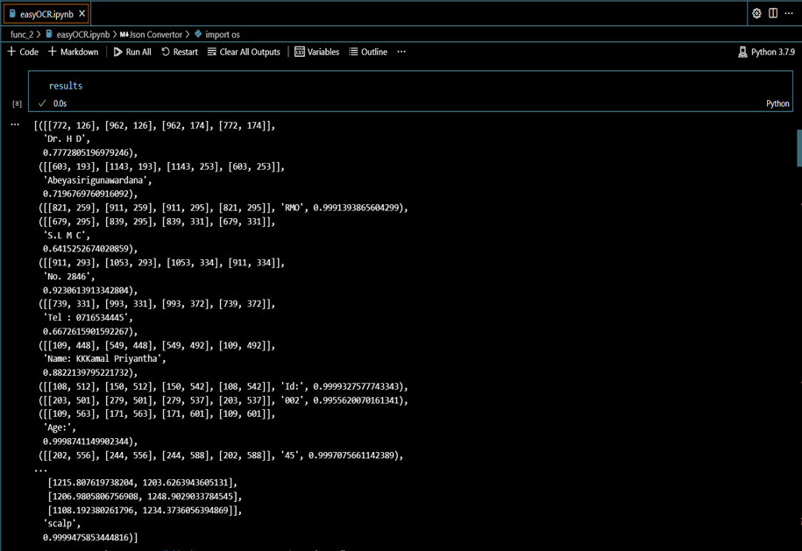
PROJECT EVIDENCE
2023 - 154
IT4010 | 2023

Slide 20
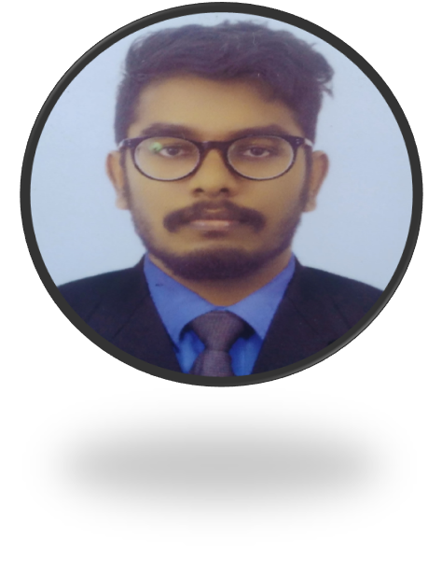
IT20159580
Nanayakkara V.G
Specialize in Information Technology​
2023 - 154
IT4010 | 2023

Slide 21

Hair Disease Treatment Recommendations using Machine Learning-based Model​
2023 - 154
IT4010 | 2023

Slide 22
BACKGROUND​
Hair Diseases Treatment Recommendation Using ML Model.
Analyze Patient Data using the Recommendation Model.
​Treatment Management.
2023 - 154
IT4010 | 2023

Slide 23
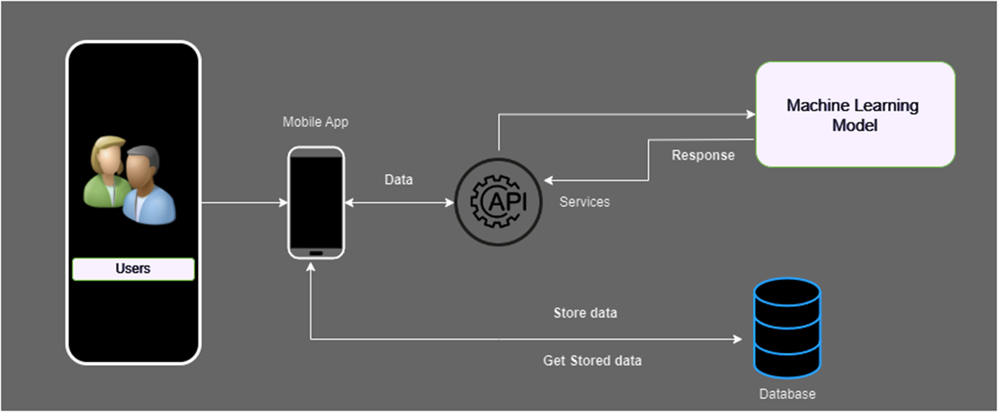
SYSTEM DIAGRAM
2023 - 154
IT4010 | 2023

Slide 24
RESEARCH GAP​
​
Allergies have not been considered in other systems before the recommended medicine.
2023 - 154
IT4010 | 2023

Slide 25
Specific Objectives
MAIN OBJECTIVE​
Considering patient preferences, to improve treatment options and empower patients to manage their own health.
SUB OBJECTIVE​
Recommend treatment via machine learning model.​
Consider patient preferences in the recommendations provided.
2023 - 154
IT4010 | 2023

Slide 26
TECHNOLOGIES
2023 - 154
IT4010 | 2023

Slide 27
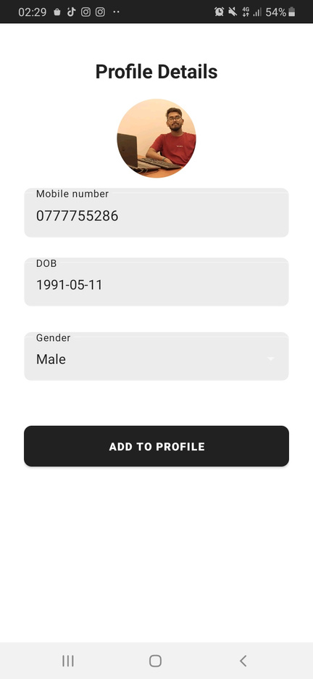
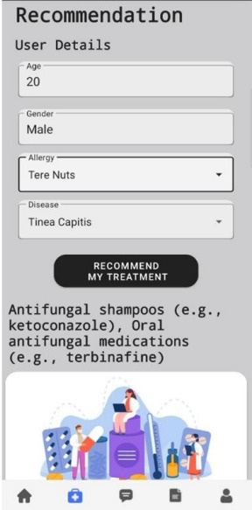
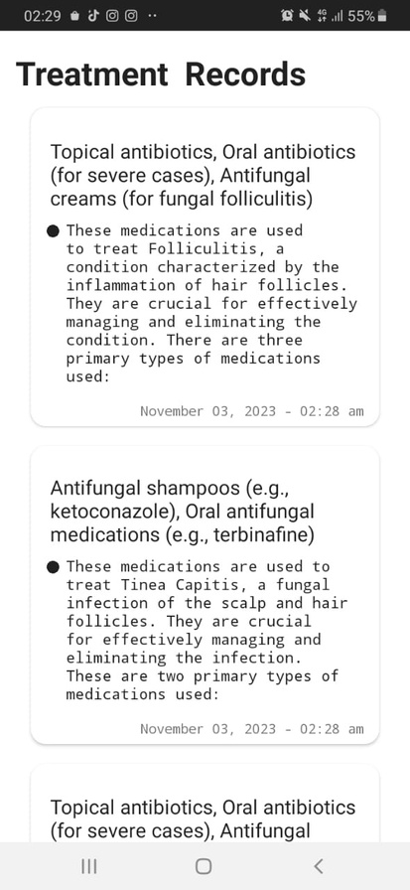
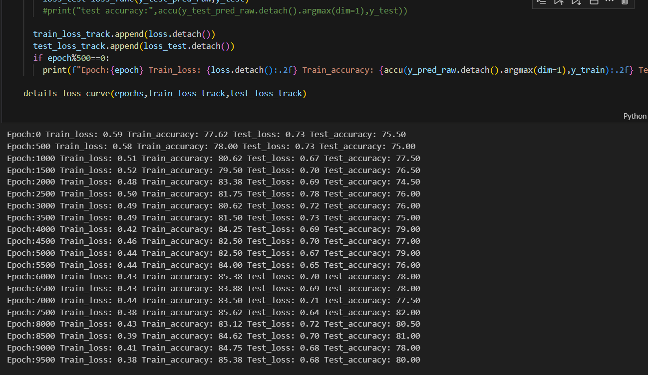
PROJECT EVIDENCE
2023 - 154
IT4010 | 2023

Slide 28
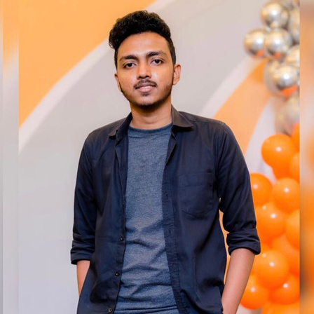
IT20232290
Bandaranayake V.R.W
Specialize in Information Technology​
2023 - 154
IT4010 | 2023

Slide 29
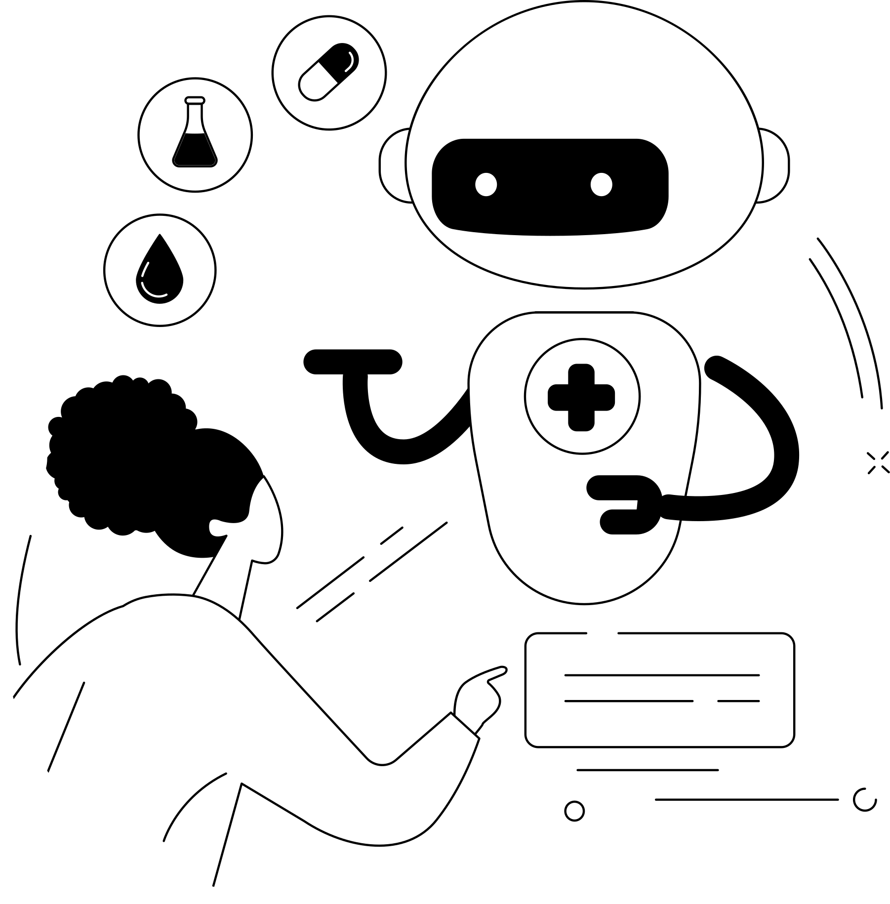
PREDICTING HAIR DISEASES USING SYMPTOMS
2023 - 154
IT4010 | 2023

Slide 30
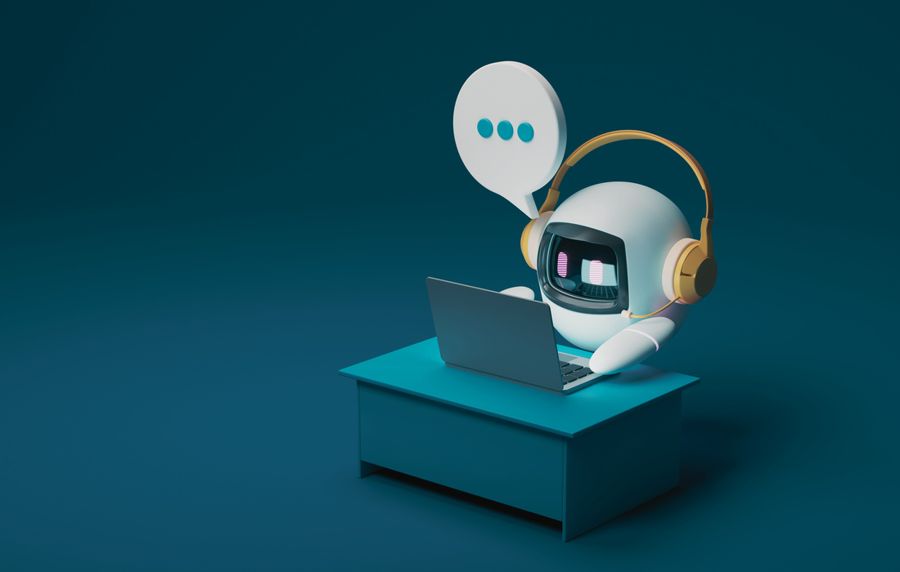
BACKGROUND​
Hair diseases symptom prediction Using chatbot.
Shows the side effects.
2023 - 154
IT4010 | 2023

Slide 31
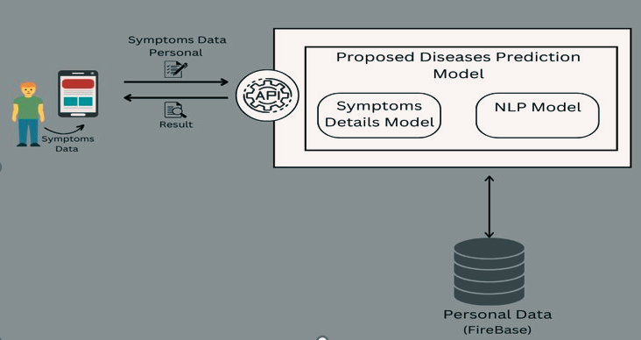
SYSTEM DIAGRAM
2023 - 154
IT4010 | 2023

Slide 32

RESEARCH GAP
​
Predicting disease symptoms by a chatbot.​
2023 - 154
IT4010 | 2023

Slide 33
Specific Objectives
MAIN OBJECTIVE​
Can diagnose the disease using the symptoms and know what side effects of the disease you have.
SUB OBJECTIVE​
Suggest the hair disease using symptoms.
Suggest the hair disease using side effects.
2023 - 154
IT4010 | 2023

Slide 34

TECHNOLOGIES
2023 - 154
IT4010 | 2023

Slide 35
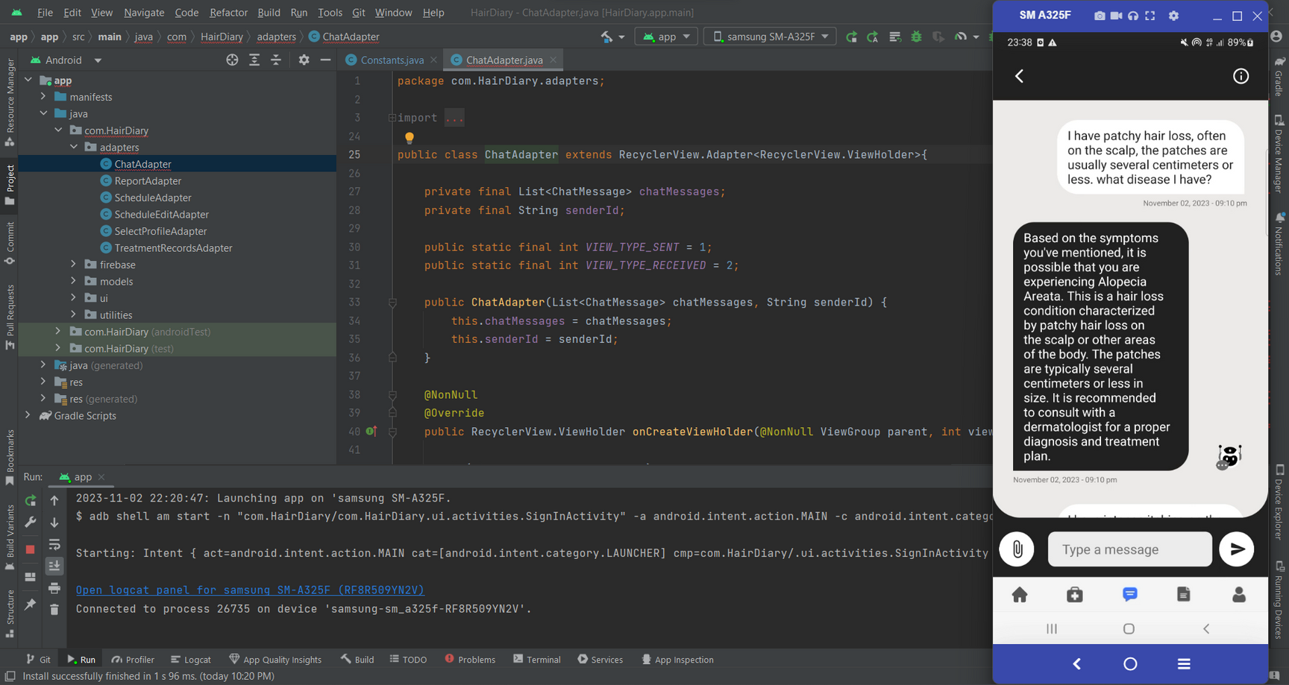
PROJECT EVIDENCE

Slide 36
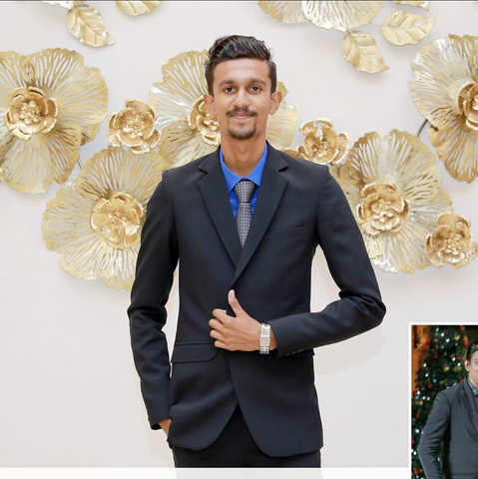
IT20129026
Alahakoon D.Y.R
Specialize in Information Technology​
2023 - 154
IT4010 | 2023

Slide 37

Smart Hair Health
Monitoring.
2023 - 154
IT4010 | 2023

Slide 38
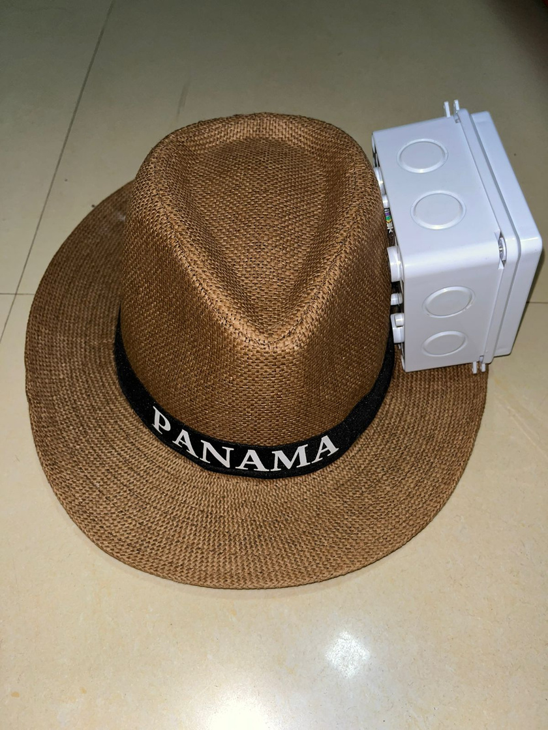
Design of IOT Hat
2023 - 154
IT4010 | 2023

Slide 39
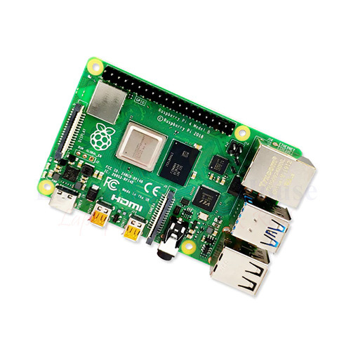
IOT Hat Components
Rasberi pi Board
Ultrasonic sensor
Sony 5MP Wide Angle Camera
MCP 3008 IC
LED Flasher
2023 - 154
IT4010 | 2023

Slide 40
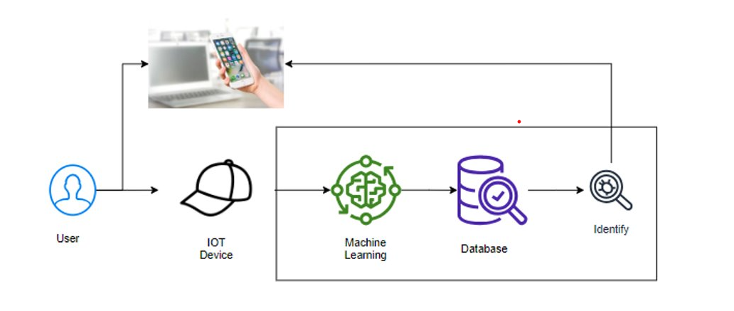
SYSTEM DIAGRAM​
​

Slide 41
RESEARCH GAP
​
Identifying hair disease using IOT Hat.
2023 - 154
IT4010 | 2023

Slide 42
Specific Objectives
MAIN OBJECTIVE​
Can identifying ware or not status and if ware hat start the image capturing.
SUB OBJECTIVE​
Identifying Hair disease
Identifying hat ware or not
2023 - 154
IT4010 | 2023

Slide 43

TECHNOLOGIES
2023 - 154
IT4010 | 2023

Slide 44
DEMOSTRATION EVIDENCE VIDEO
https://drive.google.com/file/d/1fZnQ6Mm5G-3D-5gKzJvBnfkBfhFzhBHf/view?usp=drive_link
2023 - 154
IT4010 | 2023

Slide 45
Demonstration
2023 - 154
IT4010 | 2023

Slide 46

2023 - 154
IT4010 | 2023

